Slide 1
Maths
Unit 4 – Addition and Subtraction
17.09.2026
WALT:
6Nc.02 – Recognise the use of letters to represent quantities that vary in addition and subtraction calculations.

Slide 2
Maths
Unit 4 – Addition and Subtraction
Maths - Workbook – Pages 50 – 54
ESL – Workbook pages 20 – 23
Due - Thursday 24th September

Slide 3



WALT: Recognise the use of letters to represent quantities that vary in addition and subtraction calculations.
I can find the value of letters in number sentences.
I can complete tables using letters that are represented by numbers.
I can write number sentences linking numbers and letters.

Slide 4
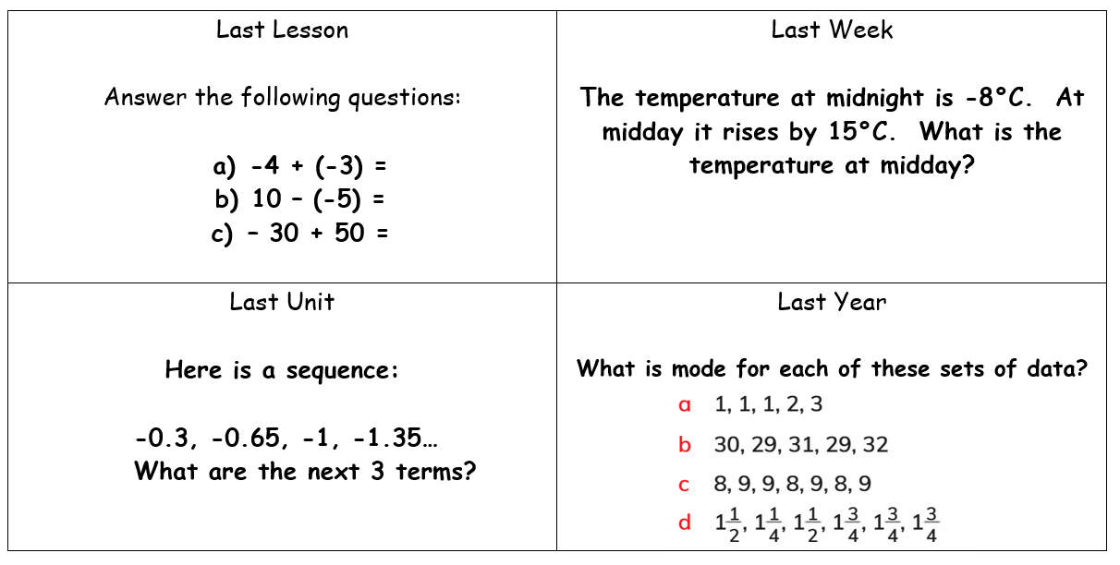
WALT: Recognise the use of letters to represent quantities that vary in addition and subtraction calculations.
Retrieval Practice

Slide 5
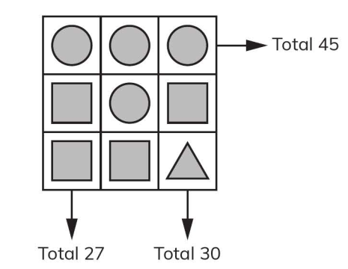



Starter – Solve this puzzle
WALT: Recognise the use of letters to represent quantities that vary in addition and subtraction calculations.
15
15
15
15
=
6
15
6
6
=
6
6
9
9
=

Slide 6
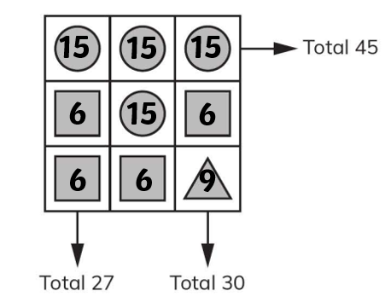
In the starter we just saw that we can represent numbers as shapes.
WALT: Recognise the use of letters to represent quantities that vary in addition and subtraction calculations.

Slide 7
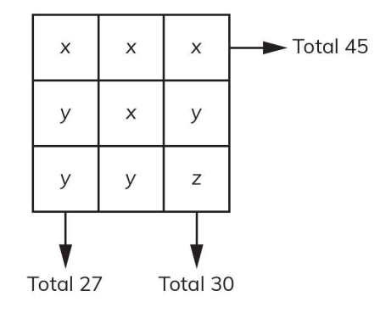
We can do the same with letters.
WALT: Recognise the use of letters to represent quantities that vary in addition and subtraction calculations.

Slide 8
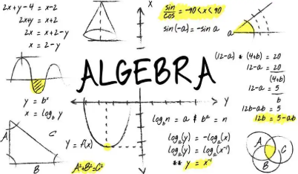
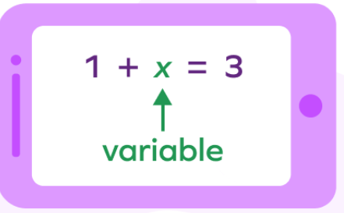
This is known as algebra!
WALT: Recognise the use of letters to represent quantities that vary in addition and subtraction calculations.
Algebra is a branch of mathematics that uses letters and symbols to represent unknown numbers and describe rules or relationships between them

Slide 9
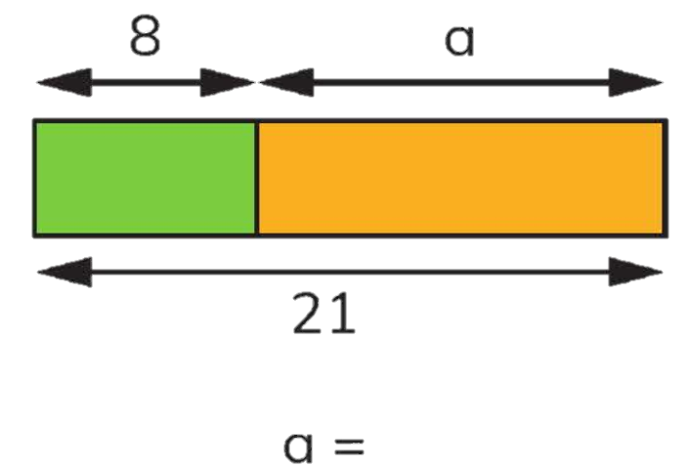
WALT: Recognise the use of letters to represent quantities that vary in addition and subtraction calculations.
Write a number sentence linking 8, a and 21.
Can you write more than one?
13

Slide 10
Check your understanding
WALT: Recognise the use of letters to represent quantities that vary in addition and subtraction calculations.
19
Write a number sentence linking 19, a and 9.
Can you write more than one?
9
a

Slide 11
Check your understanding
WALT: Recognise the use of letters to represent quantities that vary in addition and subtraction calculations.
54
Write a number sentence linking 54, a and 10.
Can you write more than one?
30
a
10

Slide 12
Mr. Jon and Ms. Colette have 10 pairs of shoes in total.
The number of pairs of shoes Mr. Jon has is J. The number of pairs of shoes Ms. Colette has is C.
WALT: Recognise the use of letters to represent quantities that vary in addition and subtraction calculations.
J | 5 |  | 6
C |  | 8 |  | 7
2
3
5
4

Slide 13
Check your understanding
WALT: Recognise the use of letters to represent quantities that vary in addition and subtraction calculations.
Mr. David always has 5 more computer mice than Mr. Josh.
The number of computer mice Mr. David has is D. The number that Mr. Josh has is J.
Copy and complete this table.
D | 7 |  | 11
J |  | 4 |  | 9
9
14
Write a number sentence linking D, J and 5.
Can you write more than one?
2
6

Slide 14
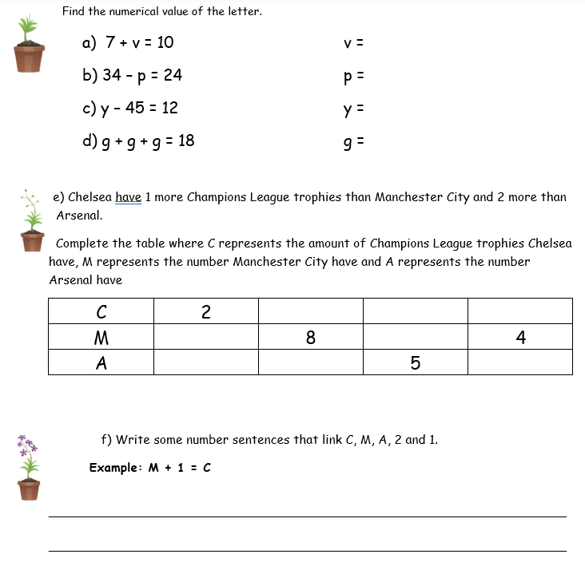
WALT: Recognise the use of letters to represent quantities that vary in addition and subtraction calculations.

Slide 15
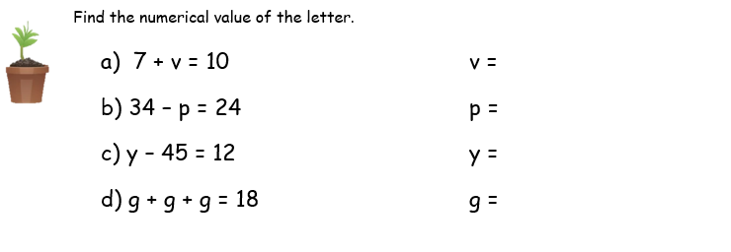
WALT: Recognise the use of letters to represent quantities that vary in addition and subtraction calculations.
3
10
57
6

Slide 16
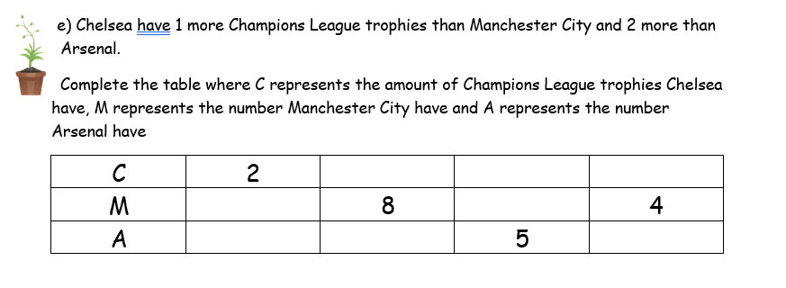
WALT: Recognise the use of letters to represent quantities that vary in addition and subtraction calculations.
9
7
5
1
6
0
7
3

Slide 17
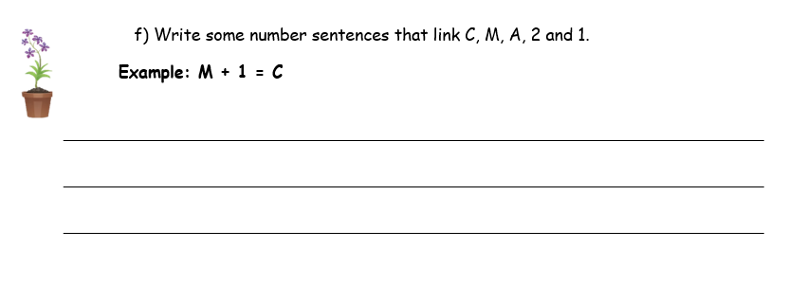
WALT: Recognise the use of letters to represent quantities that vary in addition and subtraction calculations.
A + 2 = C
A + 1 = M M – A = 1
C - A = 2 C – M = 1

Slide 18
WALT: Recognise the use of letters to represent quantities that vary in addition and subtraction calculations.
I can find the value of letters in number sentences.
I can complete tables using letters that are represented by numbers.
I can write number sentences linking numbers and letters.

Slide 19


WALT: Recognise the use of letters to represent quantities that vary in addition and subtraction calculations.
Plenary – Which of these sentences are true and which is false?
j + 6 = 6 + j
j – 6 = 6 – j

